Slide 1

Gujarat Tourism
Enhancing Tourist Experience in Gujarat

Slide 2
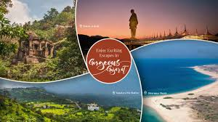
Introduction
This presentation explores the initiatives aimed at improving the tourism experience in Gujarat by addressing specific problems faced by tourists and promoting various attractions.

Slide 3
PROBLEM STATEMENT
In a Gujarat Tourism help to Tourists in Gujarat often face problems like difficulty in finding places that match their interests, navigation issues, lack of real-time updates, and limited digital assistance.

Slide 4
PURPOSE OF PROJECT
The purpose of Gujarat Tourism is to promote the state's rich cultural heritage, historical landmarks, natural beauty, and unique attractions to domestic and international tourists.
A modern and intuitive website is essential for attracting tourists.
Promoting Cultural Heritage – Showcasing Gujarat’s historical monuments, temples, forts, palaces, and UNESCO World Heritage Sites like Rani Ki Vav and Champaner-Pavagadh.
Boosting Eco-Tourism – Encouraging sustainable tourism in Gir National Park, Saputra Hills, and Marine National Park.
Encouraging Religious Tourism – Highlighting pilgrimage sites like Somnath, Dwarka, Ambaji, and Palitana.

Slide 5
Existing platform limitations
Current platforms do not adequately address the needs of travelers, failing to provide intelligent features for travel planning and real-time assistance, leading to frustration and missed opportunities for exploration.
Many tourists struggle to find reliable information about Gujarat's various attractions.
A centralized platform is needed to enhance the tourist experience.

Slide 6
ABSTRACT
Tourism is very important for Gujarat's economy. The state is famous for its rich culture, lively festivals, and diverse landscapes.
This project focuses on finding new design ideas to improve the tourism experience in Gujarat. It will focus on sustainable development, better accessibility, and promoting lesser-known tourist spots. By using user-friendly design methods and digital tools, the project aims to create a strategy that meets tourists' needs while protecting Gujarat’s natural and cultural heritage.
The main goals of this project include improving infrastructure, creating interesting digital platforms for tourists, and encouraging community involvement for long-term local benefits.
Through research, analysis, and prototypes, the project will offer practical solutions to help grow tourism in Gujarat and contribute to its economic development.

Slide 7
LITERATURE REVIEW
Key Findings:
Major Attractions – Heritage sites (Rani Ki Vav, Champaner), religious tourism (Somnath, Dwarka), wildlife tourism (Gir National Park, Rann of Kutch), and coastal tourism (Diu, Mandvi).
Government Initiatives – Policies like the Gujarat Tourism Policy 2021-2025, the "Khushboo Gujarat Ki" campaign, and heritage restoration projects have boosted tourism.
Role of Technology – AI-based recommendations, AR/VR virtual tours, IoT-enabled smart tourism, and social media promotions have enhanced visitor experiences.
Challenges – Lack of awareness about lesser-known destinations, environmental impact,
inadequate infrastructure in remote areas, and slow adoption of smart tourism technologies.

Slide 8
TECHNOLOGY
Frontend Development:
1) HTML
2) CSS
3) Java Script
4) Bootstrap
Backend Development:
1) node JS
Database:
1) MongoDB

Slide 9
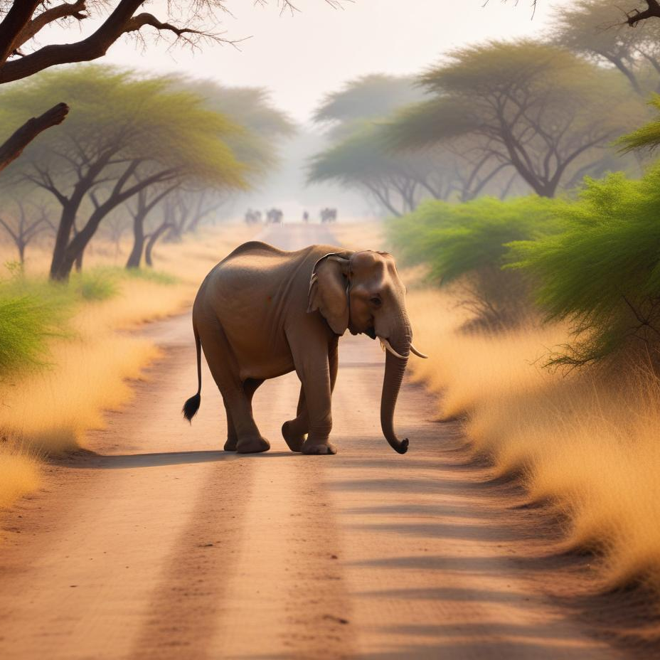
Enhancing eco-tourism
The project will actively promote eco-tourism in Gujarat, focusing on preserving natural environments while encouraging sustainable travel. Initiatives will include developing nature trails and promoting responsible wildlife tourism in areas like Gir National Park and Saputra Hills. By educating tourists on conservation and the importance of protecting biodiversity, this goal not only enhances visitor experiences but also benefits local ecosystems and communities.

Slide 10
Conclusions
The Gujarat Tourism website project aims to promote the rich cultural heritage, natural beauty, and historical significance of the state, making it accessible to both domestic and international tourists.
By integrating modern features like virtual tours, personalized itineraries, multilingual support, and real-time updates, the platform can significantly enhance the travel experience. With Gujarat's diverse offerings, from historical landmarks and wildlife sanctuaries to vibrant festivals and unique local experiences, the website will serve as a comprehensive guide.
It will not only boost tourism but also support local businesses and promote sustainable travel. In the long run, the website can position Gujarat as a premier destination, contributing to the state's economic growth and global tourism appeal.

Slide 11
REFERENCE
bing.com/ck/a?!&p=b52f84db0ceb60021814114fcb15325ef307f8f41faef8fd5b24f52da3b96c52JmltdHM9MTcyOTAzNjgwMA&ptn=3&ver=2&hsh=4&fclid=0ad07160-0135-6ed7-1cfe-626b00516f39&psq=GUJARAT+TORISUM&u=a1aHR0cHM6Ly90b3VyaXNtLmd1amFyYXQUZ292LmLuL0hvbWUvUWsW5kZXg&ntb=1
Tourism in Gujarat – Wikipedia
https://www.researchgate.net/publication/333935132_TO_STUDY_DEVELOPMENT_OF_GUJARAT_TOURISM_INDUSTRY
https://www.researchgate.net/publication/372975289_Rural_Tourism_Development_in_Gujaratviews_of_the_Stakeholders

Slide 12


